Slide 1
VE475 Project1 Shannon’s Theorem with cryptography
Kaibin Wang,
Taoyue Xia,
Wenjie Xianyu,
Yichen Hong

Slide 2
Contents
Properties:
Secrecy systems
Perfect secrecy
Entropy and equivocation
Redundancy and Unicity distance
Applications
Conclusion

Slide 3
Secrecy systems
Concealment systems
Physical approaches
Privacy systems
Technical issue
“true” secrecy systems
Kerckhoff’s principle

Slide 4
Perfect secrecy
Definition
The probability of deciding a message given a ciphertext is equal to that of randomly choose a message from the message space.
Key choice
Each key is chosen with equal probability

Slide 5
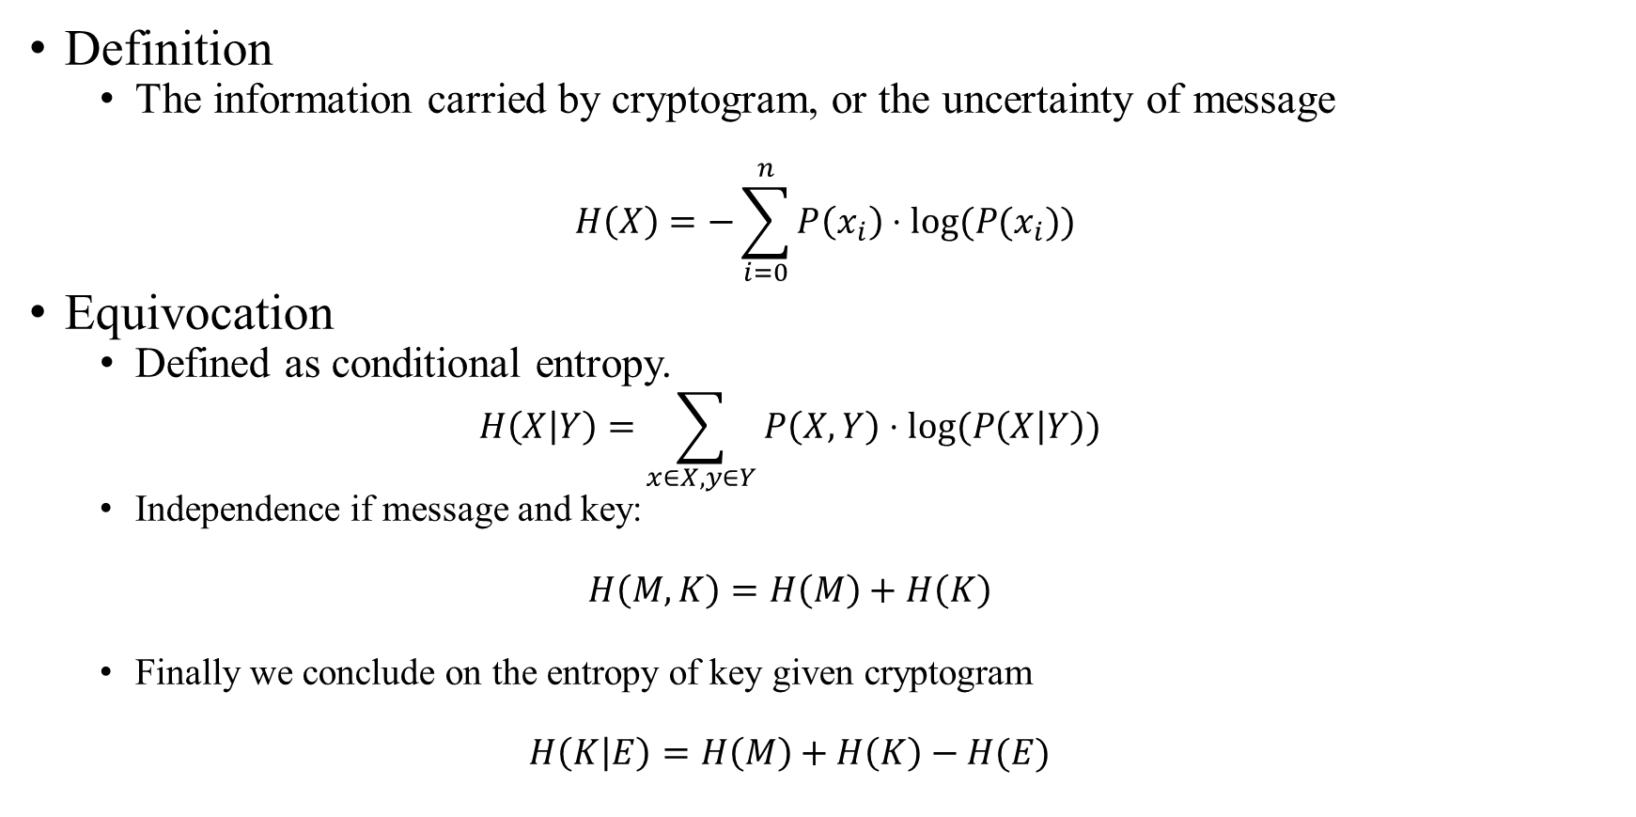
Entropy
Definition
The information carried by cryptogram, or the uncertainty of message
$$H\left(X\right)=−\sum_{i=0}^{n}{P\left(x_{i}\right)⋅log(P(x_{i}))}$$
Equivocation
Defined as conditional entropy.
$$H\left(X | Y\right)=\sum_{x∈X, y∈Y}{P\left(X, Y\right)⋅log(P\left(X | Y\right))}$$
Independence if message and key:
$$H\left(M,K\right)=H\left(M\right)+H\left(K\right)$$
Finally we conclude on the entropy of key given cryptogram
$$H\left(K | E\right)=H\left(M\right)+H\left(K\right)−H(E)$$

Slide 6
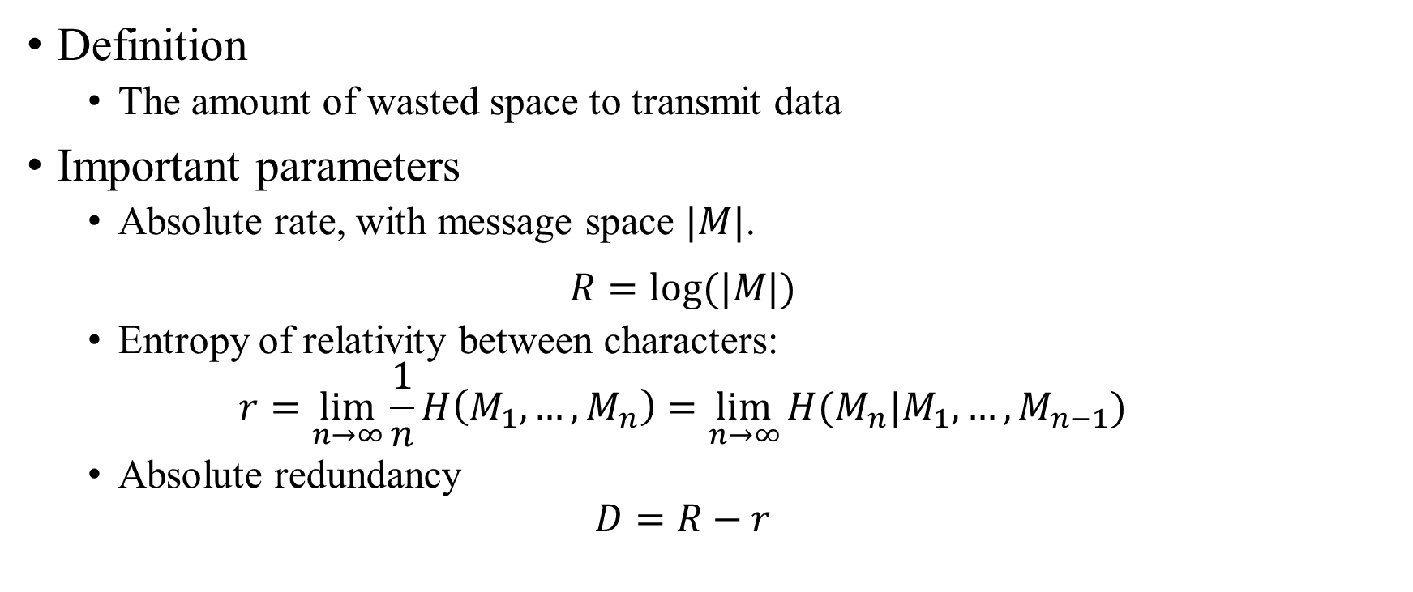
Redundancy
Definition
The amount of wasted space to transmit data
Important parameters
Absolute rate, with message space $|M|$.
$$R=log(|M|)$$
Entropy of relativity between characters:
$$r=\lim_{n→∞}{\frac{1}{n}H\left(M_{1},…,M_{n}\right)=\lim_{n→∞}{H(M_{n}|M_{1},…,M_{n−1})}}$$
Absolute redundancy
$$D=R−r$$

Slide 7
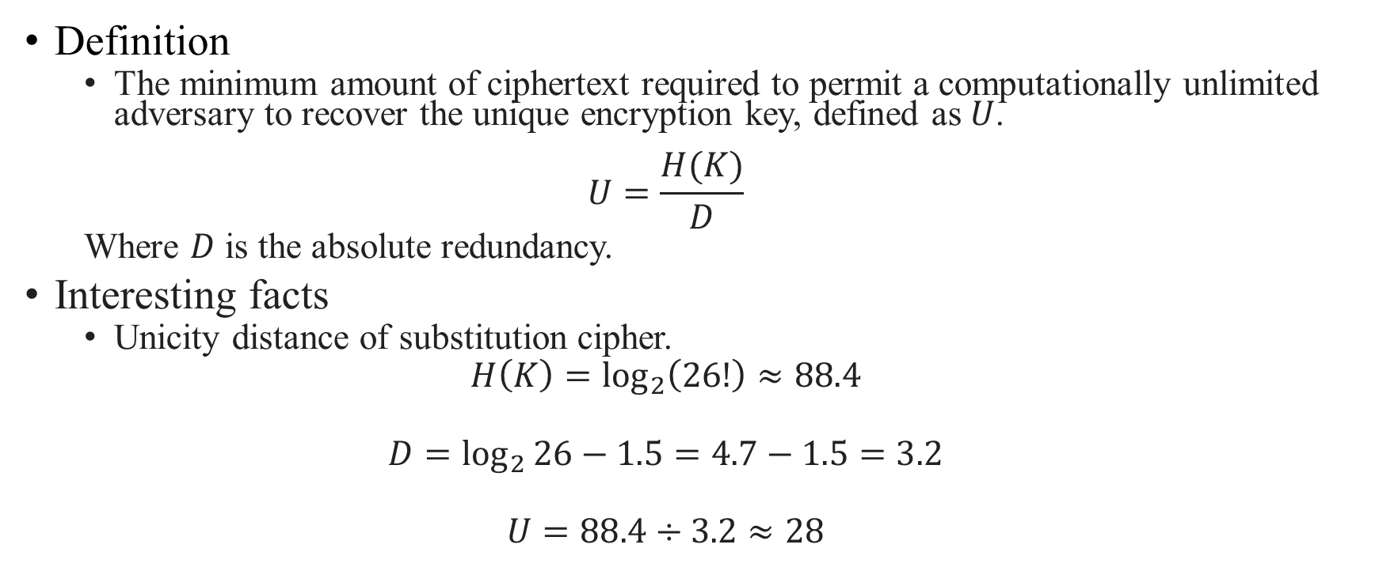
Unicity distance
Definition
The minimum amount of ciphertext required to permit a computationally unlimited adversary to recover the unique encryption key, defined as $U$.
$$U=\frac{H(K)}{D}$$
Where $D$ is the absolute redundancy.
Interesting facts
Unicity distance of substitution cipher.
$$H\left(K\right)=\log_{2}\left(26!\right)≈88.4$$
$$D=\log_{2}{26}−1.5=4.7−1.5=3.2$$
$$U=88.4÷3.2≈28$$

